Slide 1

A Synthetic Population Generator that Matches Both Household and Person Attribute Distributions
Xin Ye, Ram M. Pendyala, Karthik C. Konduri, Bhargava Sana
Department of Civil and Environmental Engineering

Slide 2

Outline
Introduction
Iterative Proportional Fitting (IPF) Algorithm
  Example to Illustrate the Algorithm
Iterative Proportional Updating (IPU) Algorithm
  Example to Illustrate the Algorithm
  Geometric Interpretation
Population Synthesis for Small Geographies
  Zero-cell Problem
  Zero-marginal Problem
Case Study
  Estimating Weights
  Creating Synthetic Households
  Performance of the Algorithm
Flowchart

Slide 3
Introduction
Emergence of Activity-based microsimulation approaches in Travel Demand Analysis
Microsimulation models simulate activity-travel patterns subject to spatio-temporal constraints, and various agent interactions
Examples
  AMOS, FAMOS, CEMDAP, ALBATROSS, TASHA etc.
  Tour-based models have been implemented in some cities including San Francisco, New York, Puget Sound etc.

Slide 4
Introduction
Activity-based models operate at the level of the individual traveler
Calibration, Validation, and Application of these models requires Household and Person attribute data for the entire population in a region
  The disaggregate data for complete population is generally not available
Data Available
  Disaggregate data for sample of the population from PUMS or Household Travel Surveys
  Aggregate distributions of Household and Person attributes for the population from Census Summary Files or Agency Forecasts
Challenge: How to obtain Household and Person attribute data for the population in a region from available data?
  Create a Synthetic Population
  Select Households and Persons from the sample to match joint distributions of key population characteristics

Slide 5
Iterative Proportional Fitting
Joint distributions of population characteristics are not readily available
  They can be estimated using Iterative Proportional Fitting (IPF) procedure
  The IPF procedure takes frequency tables constructed from PUMS or Household travel surveys as priors
  Marginal distributions from the Census Summary Files (Base Year), Population Forecasts (Future Year) are used as controls
Iterative Proportional Fitting (IPF)
  Deming and Stephan (1941) presented the method to adjust sample frequency tables to match known marginal distributions using a least squares approach
  Wong (1992) showed that the IPF yields maximum entropy estimates
Notes:
A joint distribution is a multiway table defined by key household attributes (household size, household type, income, vehicle ownership)/ person attributes (age, gender, ethnicity, and employment status)

Slide 6
Iterative Proportional Fitting
Synthetic Baseline Populations (Beckman 1996)
  Proposed a method to create synthetic population based on IPF
  Joint distribution of Household attributes was estimated using IPF
  Synthetic Households were generated by randomly selecting Households from the sample based on estimated joint distributions
  Synthetic Population comprised of persons from the selected households
  This method has been adopted widely in TDM’s based on activity-based approaches

Slide 7
Iterative Proportional Fitting
Limitation of the Beckman (1996) procedure
  The procedure only controls for household attributes and not person attributes
  As a result, synthetic populations fail to match given distributions of person characteristics
  The method assumes that all households in the sample contributing to a particular household type have same structure ( i.e. similar individual structure)
  However, the structure of households even within a same household type are generally different and hence the need to have different weights based on household structure
Guo and Bhat (2007) and Arentze (2007) constitute initial attempts to control household and person level attributes simultaneously
The proposed Iterative Proportional Updating (IPU) algorithm simultaneously controls for both household and person attributes of interest
  Reallocates the weights of the households within a same household type to account for the differences in their household structures

Slide 8
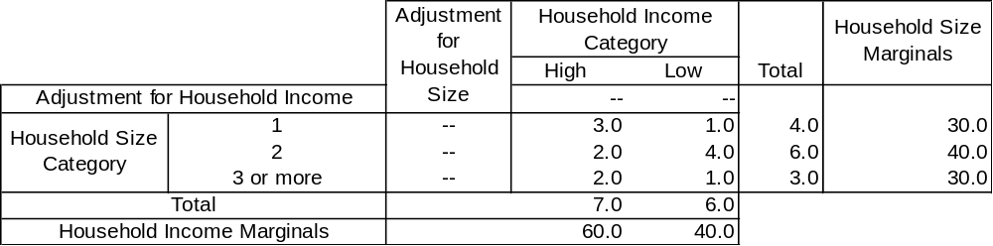
IPF Example
From PUMS or Household Travel Surveys
From Census Summary Files or Agency Forecasts

Slide 9
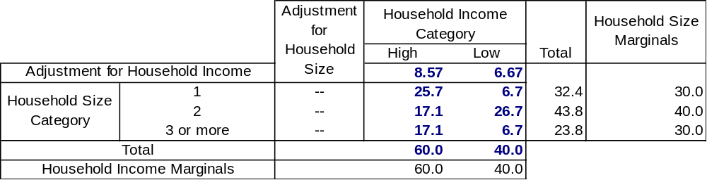
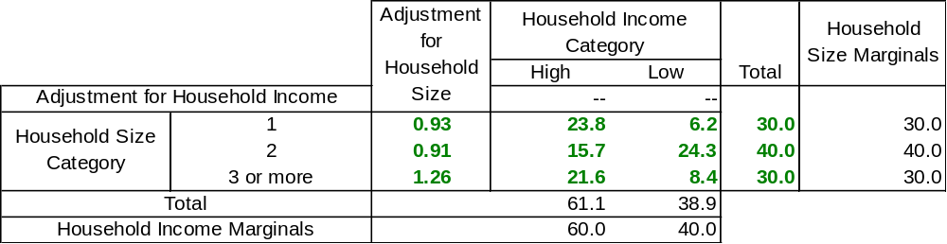
IPF Example
Iter 1: Adjust for Hhld Income
Adjustment
Adjusted Frequencies
Adjusted Totals
Iter 1: Adjust for Hhld Size
`
Adjusted Totals
Adjustment
Adjusted Frequencies

Slide 10
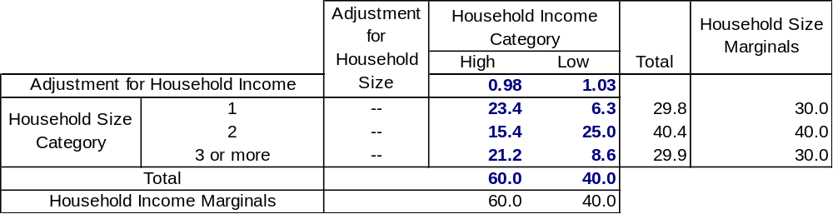
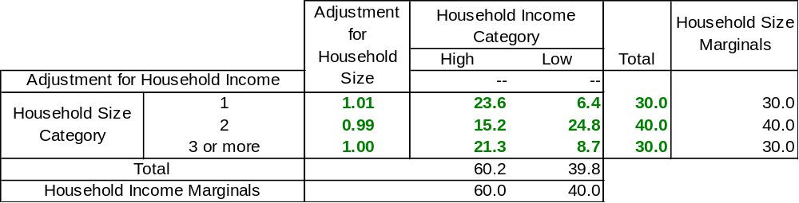
IPF Example
Iter 2: Adjust for Hhld Income
Iter 2: Adjust for Hhld Size

Slide 11
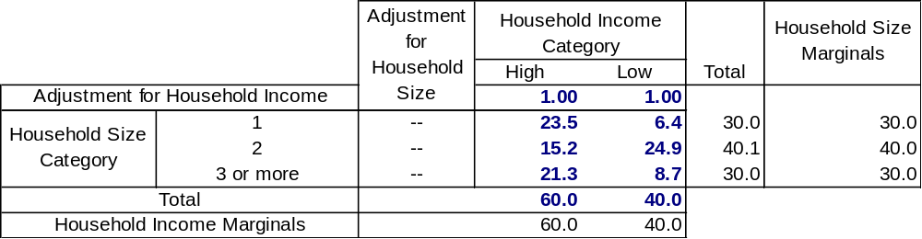
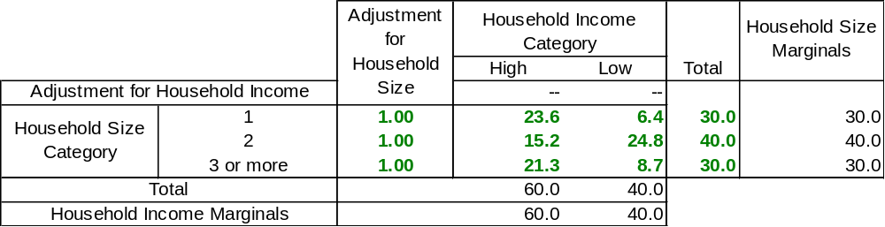
IPF Example
Iter 3: Adjust for Hhld Income
Iter 3: Adjust for Hhld Size
Convergence Reached
Hhld Type Frequencies

Slide 12
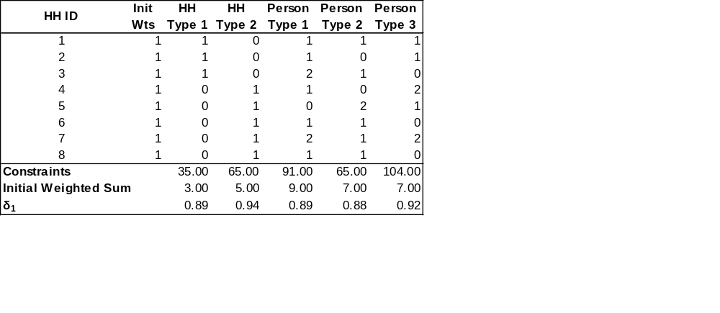
IPU: Example
Frequency Matrix
From PUMS or Household Travel Surveys
Household Constraints – From IPF using Hhld Attributes
Person Constraints – From IPF using Person Attributes

Slide 13
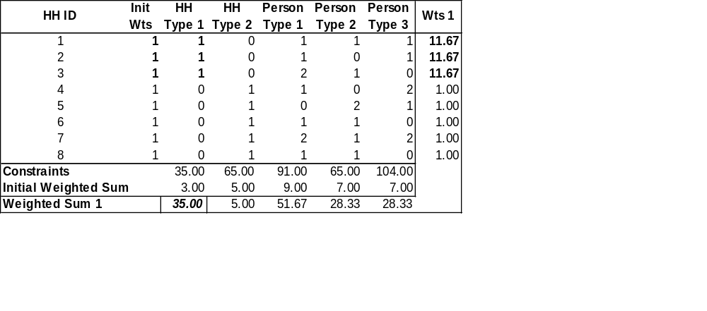
IPU: Example
Adjustment for HH Type 1

Slide 14
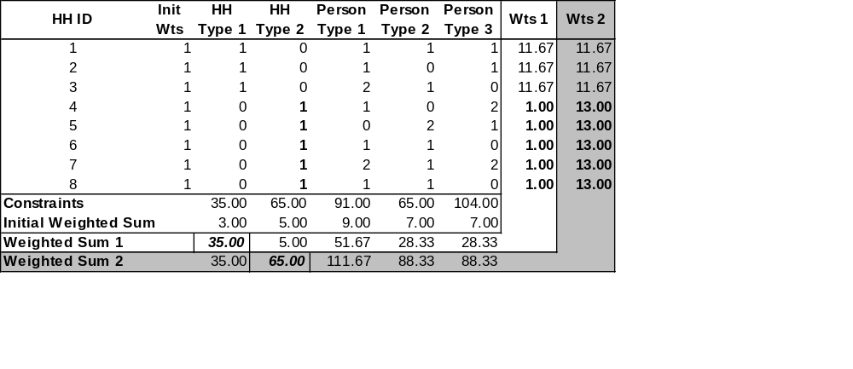
IPU: Example
Adjustment for HH Type 2

Slide 15
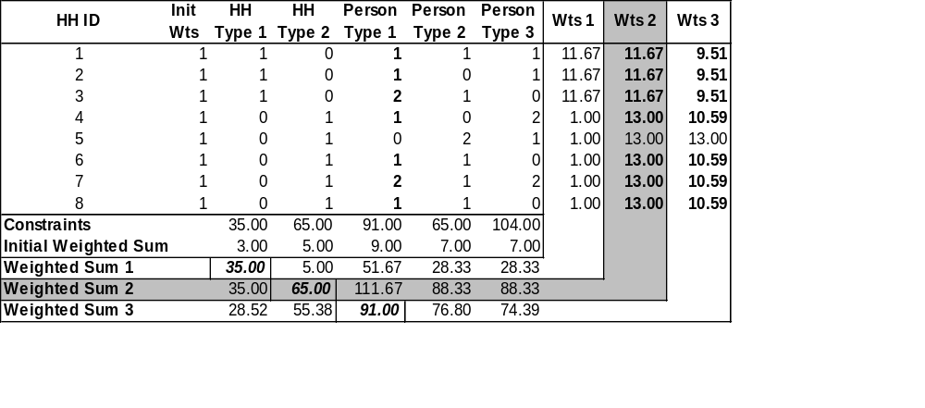
IPU: Example
Adjustment for Person Type 1

Slide 16
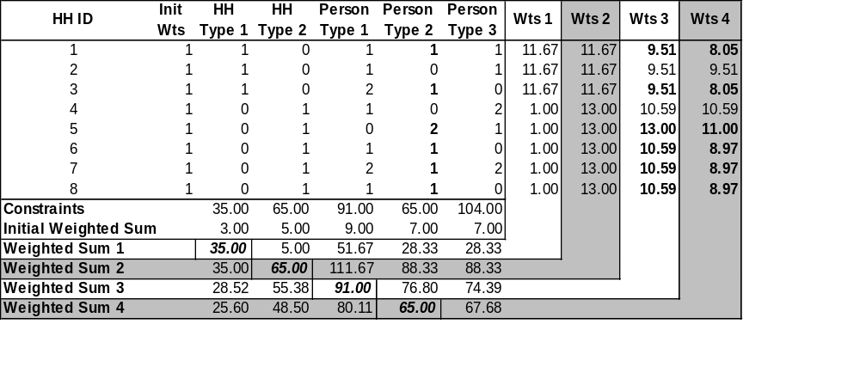
IPU: Example
Adjustment for Person Type 2

Slide 17
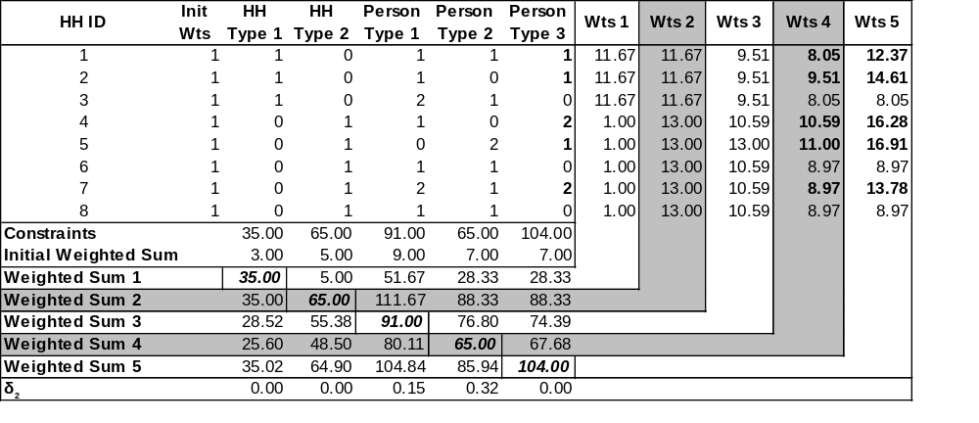
IPU: Example
Adjustment for Person Type 3

Slide 18
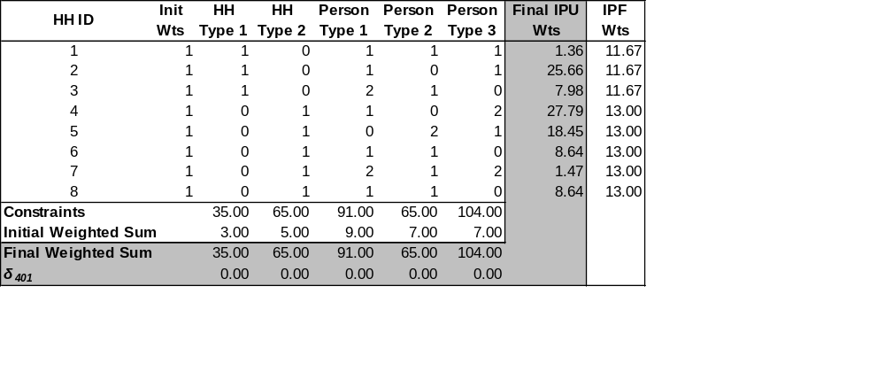
IPU: Example
Final Estimated Weights

Slide 19
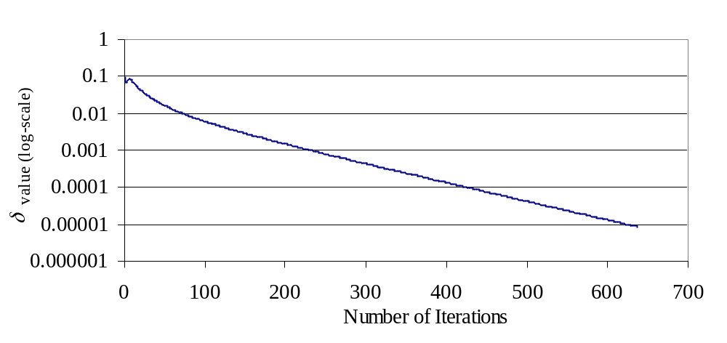
IPU Example
Improvement in Measure of Fit with Iterations

Slide 20


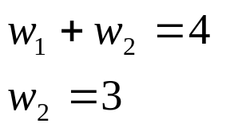
IPU: Geometric Interpretation
Sample Household Structure and Population Constraints
HH ID | HH Type | Person Type | Weights
1 | 1 | 0 | w₁
2 | 1 | 1 | w₂
Constraints | 4 | 3
Weights can be estimated by solving the following system of linear equations

Slide 21
IPU: Geometric Interpretation
When solution is within the feasible region
w₁
A
S
w₂ = 3
B
C
D
E
I
w₁ + w₂ = 4
O
w₂

Slide 22
IPU: Geometric Interpretation
When solution is outside the feasible region
w₁
w₂ = 5
w₁ + w₂ = 4
A
S
B
C
E
D
I₂
O
I₁
w₂
I

Slide 23
Population Synthesis for Small Geographies
Zero-cell Problem
  Problem
    The disaggregate sample for the sub-region (PUMA) to which the small geography belongs does not capture infrequent household types
    IPF for the geography fails to converge
  Earlier Solution
    Add a small arbitrary number to the zero-cells (Beckman 1996)
    This procedure introduces an arbitrary bias (Guo and Bhat, 2006)
  Proposed Solution
    Borrow the prior information for the zero cells from the PUMS data for the entire region subject to an upper limit on the probabilities

Slide 24
Population Synthesis for Small Geographies
PUMS for the Region
Subsample provides priors for the BG’s during IPF
Subsample for PUMA 1
BG 1
BG 2
BG 3
BG 4
Subsample for PUMA 2
Subsample may not contain all Household/ Person Types → Zero-cells
Subsample for PUMA 3
Subsample for PUMA 4

Slide 25
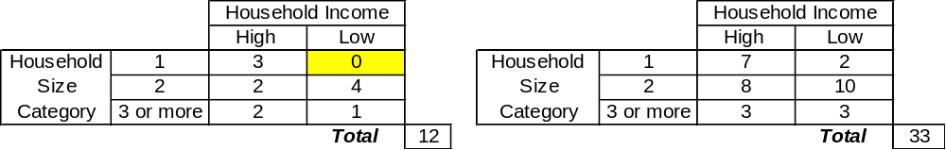
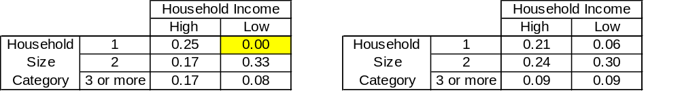
Population Synthesis for Small Geographies
Priors from PUMA to which BG belongs
Priors from PUMS
Probabilities for PUMA
Probabilities for PUMS
Threshold Probability = 1/12 = 0.083

Slide 26

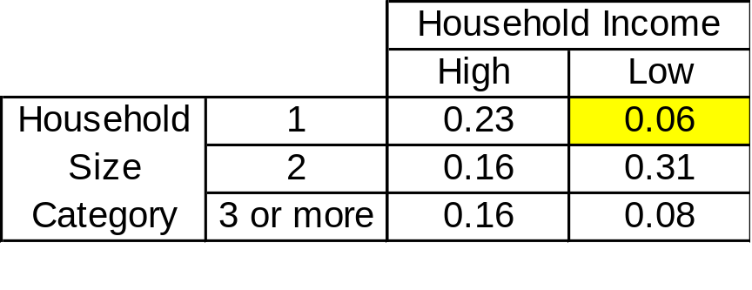
Population Synthesis for Small Geographies
Zero-cell adjusted
Probabilities from PUMS
Probability sum adds up to more than 1 (1.06), adjust probabilities for other cells
Adjusted priors from PUMA

Slide 27
Population Synthesis for Small Geographies
Zero-Marginal Problem
  Problem
    The marginal values for certain categories of an attribute take a zero value
    IPF procedure will assign a zero to all household/ person type constraints that are formed by that zero-marginal category
    As a result the IPU algorithm may fail to proceed
  Solution
    Proposed Solution: Add a small value (0.001) to the Zero-marginal categories
    IPU now proceeds as expected
    Effect of this adjustment on results is negligible

Slide 28
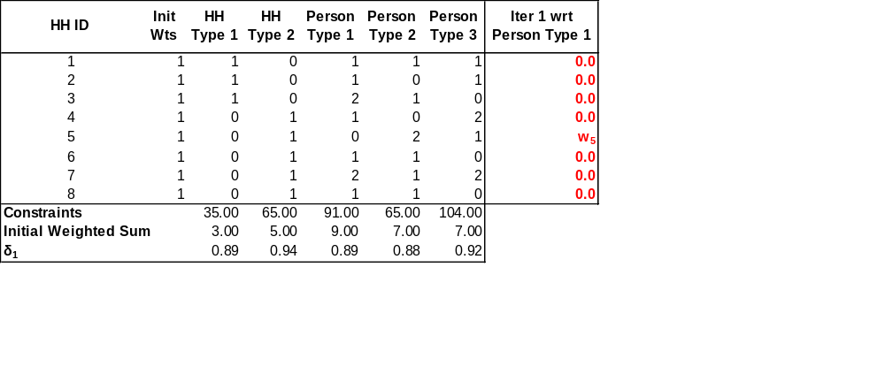
Population Synthesis for Small Geographies
- If the constraint were a zero, all the household weights except HH ID 5 are adjusted → 0
- The algorithm fails to proceed in the second iteration when we try to adjust weights wrt Household Type 1

Slide 29
Case Study: Estimating Weights
In year 2000, in Maricopa County region
  3,071,219 individuals resided in
  1,133,048 households across
  2,088 blockgroups (25 other blockgroups with 0 households)
5 percent 2000 PUMS was used as the household sample and it consists of
  254,205 individuals residing in
  95,066 households
Marginal distributions of attributes were obtained from 2000 Census Summary files
Two random blockgroups were chosen for the case study

Slide 30
Case Study: Estimating Weights
Household attributes chosen
  Household Type (5 cat.), Household Size (7 cat.), Household Income (8 cat.)
  280 different household types
Person attributes chosen
  Gender (2 cat.), Age (10 cat.), Ethnicity (7 cat.)
  140 different person types
Household and Person type constraints were estimated using IPF

Slide 31
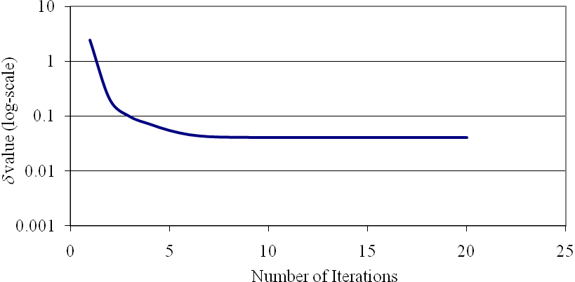
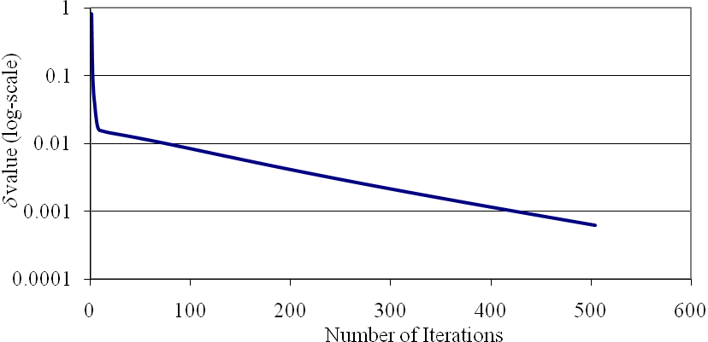
Case Study: Estimating Weights
Reduction in Average Absolute Relative Difference with the IPU algorithm
Blockgroup A
δ 2.471 → 0.041 in 20 iter.
Corner Solution Reached
Blockgroup B
δ 0.8151 → 0.00064 in 500 iter.
Near-perfect Solution Obtained

Slide 32
Case Study: Drawing Households
Joint household distribution from IPF gives the frequencies of different household types to be drawn
Proposed method of drawing households
  IPF frequencies are rounded
  The difference between the rounded frequency sum and the actual household total is adjusted
  Households are drawn probabilistically based on IPU estimated weights for each Household Type

Slide 33
Case Study: Algorithm Performance
Average Absolute Relative Difference
  Used for monitoring convergence of IPU
  It masks the difference in magnitude between estimated and expected values
  Cannot be used to measure the fit of the synthetic population
Chi-squared Statistic (τ)
  Provides a statistical procedure for comparing distributions
  χ²_{J-1}(τ) gives the level of confidence
  Confidence level very close to one is desired for the synthetic household draw
  This was used to compare the joint distribution of the synthesized individuals with the IPF generated person joint distribution

Slide 34
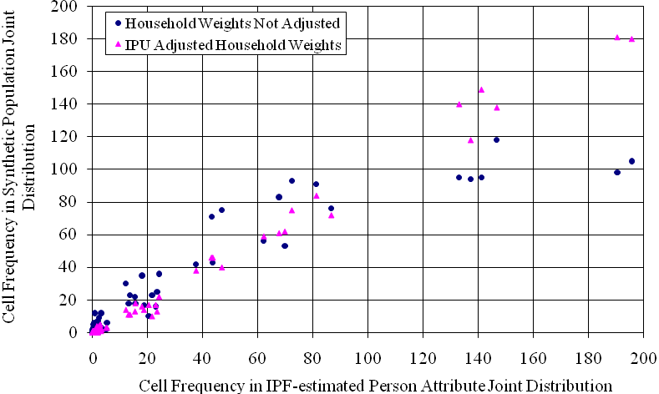
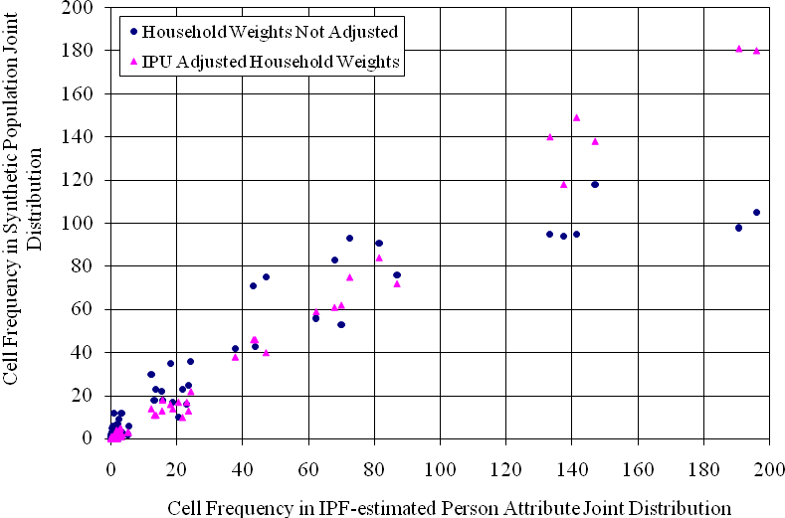
Case Study: Algorithm Performance
Blockgroup A
τ = 74.77, dof = 119, p-value = 0.999
Blockgroup B
τ = 52.01, dof = 99, p-value = 1.000

Slide 35
Computational Performance
Synthetic Population was also generated for entire Maricopa County
  Population synthesized for 2088 blockgroups
  A Dell Precision Workstation with Quad Core Intel Xeon Processor was used
  Coded in Python and MySQL database was used
  Code was parallelized using Parallel Python module
  Run time was ~ 4 hours → ~7 seconds per geography
  Please note that the actual processing time is ~28 seconds per geography i.e. if run on a single core system it will take approximately 28 seconds per geography

Slide 36
Population Synthesis: Flowchart
Household and Person
5% PUMS Data
Marginals from Census Summary Files (SF)
Step 1: Obtain Household and Person Level Constraints
Priors for a particular PUMA are corrected to account for the Zero-cell Problem
Marginals are corrected to account for the Zero-Marginal Problem
Run IPF procedure to obtain Household and Person level joint distributions.
Step 2

Slide 37
Population Synthesis: Flowchart
Step 2: Estimate Weights to satisfy the Household and Person level joint distributions from Step 1 using IPU
Household and Person
5% PUMS Data
Create Frequency Matrix D_{N x m}, where d_{i , j} in the matrix gives the contribution of a PUMS Household to the particular Household/ Person type
Column constraints for Household/ Person types are obtained from Step 1
Iteration
For all Household/ Person Types, the weights of PUMS Households contributing to a particular Household/ Person type are adjusted to match the corresponding constraint
Compute Goodness of Fit δ
If difference in δ for successive iterations < ε
No
Yes
Step 3

Slide 38
Population Synthesis: Flowchart
Step 3: Drawing Households
Round the Household level joint distributions from Step 1 and correct them for rounding errors, this gives the Frequency of Households types to be selected
For each Household type, estimate Household selection probability distribution using the IPU adjusted weights
Iteration
Create synthetic population by randomly selecting Households based on the probability distributions computed for each Household type
Compute a χ² statistic, comparing the Person joint distribution of the synthetic population with the Person joint distributions from Step 1
If the P-value corresponding to χ² statistic > 0.9999
No
Yes
Store Synthetic population for the geography

Slide 39
In the near Future
Build a GUI
Port the results to the geography’s polygon shape file
Use PostgreSQL for databases
Test the code on ASU’s High Performance Cluster
Document the algorithm/program on a wiki

Slide 40

Thank You!
Website: http://www.ined.fr
Questions & Comments…

